Slide 1
Introduction to MapReduce/Hadoop
Adopted from Jimmy Lin’s slides (at UMD)

Slide 2
Slides from Dr. Amr Awadallah’s Hadoop talk at Stanford, CTO & VPE from Cloudera

Slide 3
Typical Large-Data Problem
Iterate over a large number of records
Extract something of interest from each
Shuffle and sort intermediate results
Aggregate intermediate results
Generate final output
The problem:
Diverse input format (data diversity & heterogeneity)
Large Scale: Terabytes, Petabytes
Parallelization
(Dean and Ghemawat, OSDI 2004)

Slide 4
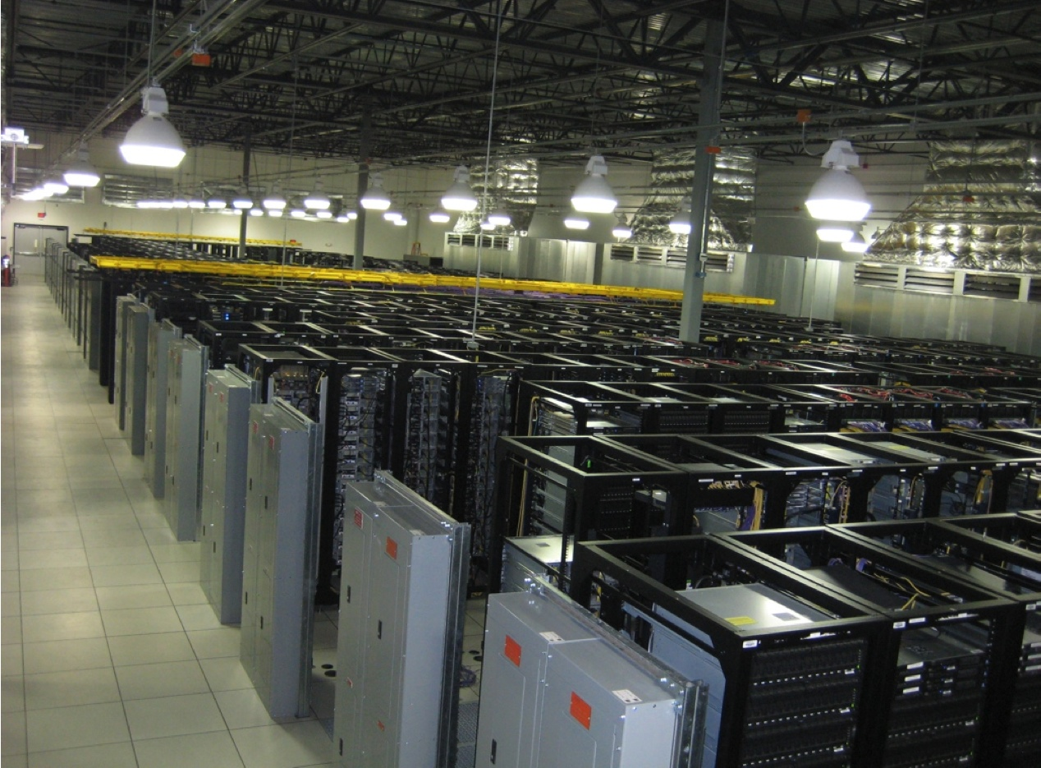
How to leverage a number of cheap off-the-shelf computers?
Image from http://wiki.apache.org/hadoop-data/attachments/HadoopPresentations/attachments/aw-apachecon-eu-2009.pdf

Slide 5
Divide and Conquer
“Work”
Partition
w₁
w₂
w₃
“worker”
“worker”
“worker”
r₁
r₂
r₃
Combine
“Result”

Slide 6
Parallelization Challenges
How do we assign work units to workers?
What if we have more work units than workers?
What if workers need to share partial results?
How do we aggregate partial results?
How do we know all the workers have finished?
What if workers die?
What is the common theme of all of these problems?

Slide 7
Common Theme?
Parallelization problems arise from:
Communication between workers (e.g., to exchange state)
Access to shared resources (e.g., data)
Thus, we need a synchronization mechanism

Slide 8
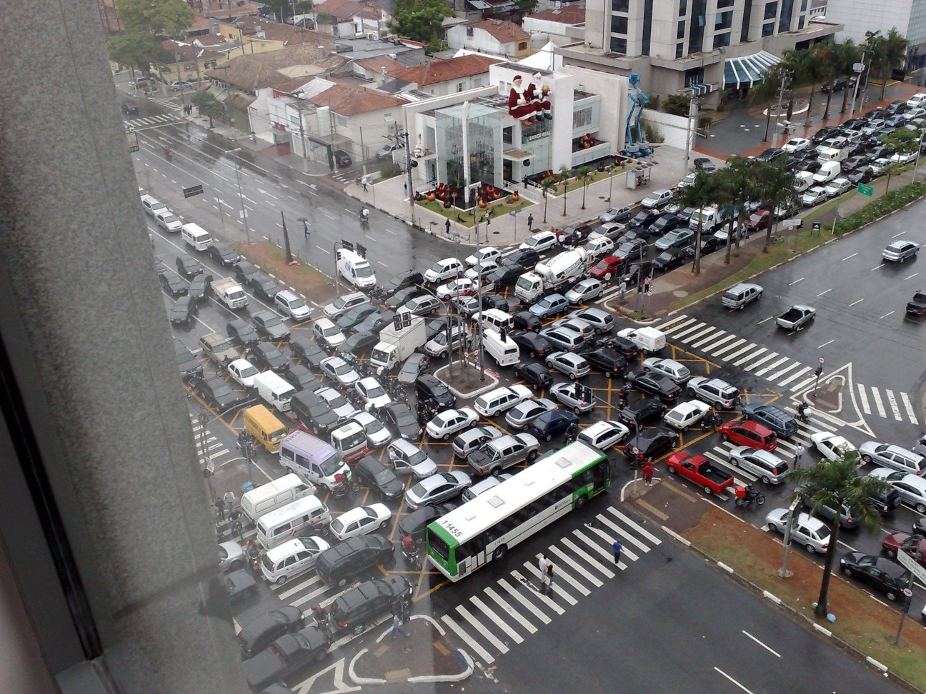
Source: Ricardo Guimarães Herrmann

Slide 9
Managing Multiple Workers
Difficult because
We don’t know the order in which workers run
We don’t know when workers interrupt each other
We don’t know the order in which workers access shared data
Thus, we need:
Semaphores (lock, unlock)
Conditional variables (wait, notify, broadcast)
Barriers
Still, lots of problems:
Deadlock, livelock, race conditions...
Dining philosophers, sleeping barbers, cigarette smokers...
Moral of the story: be careful!

Slide 10
Current Tools
Shared Memory
Message Passing
Programming models
Shared memory (pthreads)
Message passing (MPI)
Design Patterns
Master-slaves
Producer-consumer flows
Shared work queues
Memory
P₁
P₂
P₃
P₄
P₅
P₁
P₂
P₃
P₄
P₅
producer
consumer
master
work queue
slaves
producer
consumer

Slide 11
Concurrency Challenge!
Concurrency is difficult to reason about
Concurrency is even more difficult to reason about
At the scale of datacenters (even across datacenters)
In the presence of failures
In terms of multiple interacting services
Not to mention debugging…
The reality:
Lots of one-off solutions, custom code
Write you own dedicated library, then program with it
Burden on the programmer to explicitly manage everything

Slide 12
What’s the point?
It’s all about the right level of abstraction
The von Neumann architecture has served us well, but is no longer appropriate for the multi-core/cluster environment
Hide system-level details from the developers
No more race conditions, lock contention, etc.
Separating the what from how
Developer specifies the computation that needs to be performed
Execution framework (“runtime”) handles actual execution

Slide 13
Key Ideas
Scale “out”, not “up”
Limits of SMP and large shared-memory machines
Move processing to the data
Cluster have limited bandwidth
Process data sequentially, avoid random access
Seeks are expensive, disk throughput is reasonable
Seamless scalability
From the mythical man-month to the tradable machine-hour

Slide 14
The datacenter is the computer!
Image from http://wiki.apache.org/hadoop-data/attachments/HadoopPresentations/attachments/aw-apachecon-eu-2009.pdf

Slide 15
Apache Hadoop
Scalable fault-tolerant distributed system for Big Data:
Data Storage
Data Processing
A virtual Big Data machine
Borrowed concepts/Ideas from Google; Open source under the Apache license
Core Hadoop has two main systems:
Hadoop/MapReduce: distributed big data processing infrastructure (abstract/paradigm, fault-tolerant, schedule, execution)
HDFS (Hadoop Distributed File System): fault-tolerant, high-bandwidth, high availability distributed storage

Slide 16
MapReduce: Big Data Processing Abstraction

Slide 17
Typical Large-Data Problem
Map
Iterate over a large number of records
Extract something of interest from each
Shuffle and sort intermediate results
Aggregate intermediate results
Generate final output
Reduce
Key idea: provide a functional abstraction for these two operations
(Dean and Ghemawat, OSDI 2004)

Slide 18
Roots in Functional Programming
Map
f
f
f
f
f
Fold
g
g
g
g
g

Slide 19
MapReduce
Programmers specify two functions:
map (k, v) → [(k’, v’)]
reduce (k’, [v’]) → [(k’, v’)]
All values with the same key are sent to the same reducer
The execution framework handles everything else…

Slide 20
Key Observation from Data Mining Algorithms (Jin & Agrawal, SDM’01)
Popular algorithms have a common canonical loop
Can be used as the basis for supporting a common middleware (FREERide, Framework for Rapid Implementation of Data mining Engines)
Target distributed memory parallelism, shared memory parallelism, and combination
Ability to process large and disk-resident datasets
While( ) {
forall( data instances d) {
I = process(d)
R(I) = R(I) op d
}
…….
}

Slide 21
k₁
v₁
k₂
v₂
k₃
v₃
k₄
v₄
k₅
v₅
k₆
v₆
map
map
map
map
a
1
b
2
c
3
c
6
a
5
c
2
b
7
c
8
Shuffle and Sort: aggregate values by keys
a
1
5
b
2
7
c
2
3
6
8
reduce
reduce
reduce
r₁
s₁
r₂
s₂
r₃
s₃

Slide 22
MapReduce
Programmers specify two functions:
map (k, v) → <k’, v’>*
reduce (k’, v’) → <k’, v’>*
All values with the same key are sent to the same reducer
The execution framework handles everything else…
What’s “everything else”?

Slide 23
MapReduce “Runtime”
Handles scheduling
Assigns workers to map and reduce tasks
Handles “data distribution”
Moves processes to data
Handles synchronization
Gathers, sorts, and shuffles intermediate data
Handles errors and faults
Detects worker failures and restarts
Everything happens on top of a distributed FS (later)

Slide 24
MapReduce
Programmers specify two functions:
map (k, v) → [(k’, v’)]
reduce (k’, [v’]) → [(k’, v’)]
All values with the same key are reduced together
The execution framework handles everything else…
Not quite…usually, programmers also specify:
partition (k’, number of partitions) → partition for k’
Often a simple hash of the key, e.g., hash(k’) mod n
Divides up key space for parallel reduce operations
combine (k’, [v’]) → [(k’, v’’)]
Mini-reducers that run in memory after the map phase
Used as an optimization to reduce network traffic

Slide 25
k₁
v₁
k₂
v₂
k₃
v₃
k₄
v₄
k₅
v₅
k₆
v₆
map
map
map
map
a
1
b
2
c
3
c
6
a
5
c
2
b
7
c
8
combine
combine
combine
combine
a
1
b
2
c
9
a
5
c
2
b
7
c
8
partition
partition
partition
partition
Shuffle and Sort: aggregate values by keys
a
1
5
b
2
7
c
c
2
2
9
3
8
6
8
reduce
reduce
reduce
r₁
s₁
r₂
s₂
r₃
s₃

Slide 26
Two more details…
Barrier between map and reduce phases
But we can begin copying intermediate data earlier
Keys arrive at each reducer in sorted order
No enforced ordering across reducers

Slide 27
MapReduce can refer to…
The programming model
The execution framework (aka “runtime”)
The specific implementation
Usage is usually clear from context!

Slide 28
“Hello World”: Word Count
Map(String docid, String text):
for each word w in text:
Emit(w, 1);
Reduce(String term, Iterator<Int> values):
int sum = 0;
for each v in values:
sum += v;
Emit(term, sum);

Slide 29
MapReduce Implementations
Google has a proprietary implementation in C++
Bindings in Java, Python
Hadoop is an open-source implementation in Java
Development led by Yahoo, used in production
Now an Apache project
Rapidly expanding software ecosystem
Lots of custom research implementations
For GPUs, cell processors, etc.

Slide 30
Hadoop History
Dec 2004 – Google GFS paper published
July 2005 – Nutch uses MapReduce
Feb 2006 – Becomes Lucene subproject
Apr 2007 – Yahoo! on 1000-node cluster
Jan 2008 – An Apache Top Level Project
Jul 2008 – A 4000 node test cluster
Sept 2008 – Hive becomes a Hadoop subproject
Feb 2009 – The Yahoo! Search Webmap is a Hadoop application that runs on more than 10,000 core Linux cluster and produces data that is now used in every Yahoo! Web search query.
June 2009 – On June 10, 2009, Yahoo! made available the source code to the version of Hadoop it runs in production.
In 2010 Facebook claimed that they have the largest Hadoop cluster in the world with 21 PB of storage. On July 27, 2011 they announced the data has grown to 30 PB.
Notes:
.^{[24]} Yahoo! contributes back all work it does on Hadoop to the open-source community, the company's developers also fix bugs and provide stability improvements internally, and release this patched source code so that other users may benefit from their effort.

Slide 31
Who uses Hadoop?
Amazon/A9
Facebook
Google
IBM
Joost
Last.fm
New York Times
PowerSet
Veoh
Yahoo!

Slide 32
Example Word Count (Map)
public static class TokenizerMapper
extends Mapper<Object, Text, Text, IntWritable>{
private final static IntWritable one = new IntWritable(1);
private Text word = new Text();
public void map(Object key, Text value, Context context
) throws IOException, InterruptedException {
StringTokenizer itr = new StringTokenizer(value.toString());
while (itr.hasMoreTokens()) {
word.set(itr.nextToken());
context.write(word,one);
}
}
}

Slide 33
Example Word Count (Reduce)
public static class IntSumReducer
extends Reducer<Text,IntWritable,Text,IntWritable> {
private IntWritable result = new IntWritable();
public void reduce(Text key, Iterable<IntWritable> values,
Context context
) throws IOException, InterruptedException {
int sum = 0;
for (IntWritable val : values) {
sum += val.get();
}
result.set(sum);
context.write(key, result);
}
}

Slide 34
Example Word Count (Driver)
public static void main(String[] args) throws Exception {
Configuration conf = new Configuration();
String[] otherArgs = new GenericOptionsParser(conf, args).getRemainingArgs();
if (otherArgs.length != 2) {
System.err.println("Usage: wordcount <in> <out>");
System.exit(2);
}
Job job = new Job(conf, "word count");
job.setJarByClass(WordCount.class);
job.setMapperClass(TokenizerMapper.class);
job.setCombinerClass(IntSumReducer.class);
job.setReducerClass(IntSumReducer.class);
job.setOutputKeyClass(Text.class);
job.setOutputValueClass(IntWritable.class);
FileInputFormat.addInputPath(job, new Path(otherArgs[0]));
FileOutputFormat.setOutputPath(job, new Path(otherArgs[1]));
System.exit(job.waitForCompletion(true) ? 0 : 1);
}

Slide 35
Word Count Execution
Input
Map
Shuffle & Sort
Reduce
Output
the, 1
brown, 1
fox, 1
the quick
brown fox
Map
brown, 2
fox, 2
how, 1
now, 1
the, 3
Reduce
the, 1
fox, 1
the, 1
the fox ate
the mouse
Map
quick, 1
how, 1
now, 1
brown, 1
ate, 1
cow, 1
mouse, 1
quick, 1
ate, 1
mouse, 1
Reduce
how now
brown cow
Map
cow, 1

Slide 36
An Optimization: The Combiner
A combiner is a local aggregation function for repeated keys produced by same map
For associative ops. like sum, count, max
Decreases size of intermediate data
Example: local counting for Word Count:
def combiner(key, values):
output(key, sum(values))

Slide 37
Word Count with Combiner
Input
Map & Combine
Shuffle & Sort
Reduce
Output
the, 1
brown, 1
fox, 1
the quick
brown fox
Map
brown, 2
fox, 2
how, 1
now, 1
the, 3
Reduce
the, 2
fox, 1
the fox ate
the mouse
Map
quick, 1
how, 1
now, 1
brown, 1
ate, 1
cow, 1
mouse, 1
quick, 1
ate, 1
mouse, 1
Reduce
how now
brown cow
Map
cow, 1

Slide 38
User Program
(1) submit
Master
(2) schedule map
(2) schedule reduce
worker
split 0
(6) write
output
file 0
split 1
(5) remote read
worker
split 2
(3) read
(4) local write
split 3
worker
split 4
worker
output
file 1
worker
Input
files
Map
phase
Intermediate files
(on local disk)
Reduce
phase
Output
files
Adapted from (Dean and Ghemawat, OSDI 2004)

Slide 39

How do we get data to the workers?
NAS
SAN
Compute Nodes
What’s the problem here?

Slide 40
Distributed File System
Don’t move data to workers… move workers to the data!
Store data on the local disks of nodes in the cluster
Start up the workers on the node that has the data local
Why?
Not enough RAM to hold all the data in memory
Disk access is slow, but disk throughput is reasonable
A distributed file system is the answer
GFS (Google File System) for Google’s MapReduce
HDFS (Hadoop Distributed File System) for Hadoop

Slide 41
GFS: Assumptions
Commodity hardware over “exotic” hardware
Scale “out”, not “up”
High component failure rates
Inexpensive commodity components fail all the time
“Modest” number of huge files
Multi-gigabyte files are common, if not encouraged
Files are write-once, mostly appended to
Perhaps concurrently
Large streaming reads over random access
High sustained throughput over low latency
GFS slides adapted from material by (Ghemawat et al., SOSP 2003)

Slide 42
GFS: Design Decisions
Files stored as chunks
Fixed size (64MB)
Reliability through replication
Each chunk replicated across 3+ chunkservers
Single master to coordinate access, keep metadata
Simple centralized management
No data caching
Little benefit due to large datasets, streaming reads
Simplify the API
Push some of the issues onto the client (e.g., data layout)
HDFS = GFS clone (same basic ideas)

Slide 43
From GFS to HDFS
Terminology differences:
GFS master = Hadoop namenode
GFS chunkservers = Hadoop datanodes
Functional differences:
HDFS performance is (likely) slower
For the most part, we’ll use the Hadoop terminology…

Slide 44
HDFS Working Flow
HDFS namenode
Application
/foo/bar
(file name, block id)
File namespace
HDFS Client
block 3df2
(block id, block location)
instructions to datanode
(block id, byte range)
datanode state
HDFS datanode
HDFS datanode
block data
Linux file system
Linux file system
…
…
Adapted from (Ghemawat et al., SOSP 2003)

Slide 45
HDFS Architecture
Cluster Membership
NameNode
1. filename
2. BlckId, DataNodes
o
Secondary
NameNode
Client
3.Read data
Cluster Membership
NameNode : Maps a file to a file-id and list of MapNodes
DataNode : Maps a block-id to a physical location on disk
SecondaryNameNode: Periodic merge of Transaction log
DataNodes

Slide 46
Distributed File System
Single Namespace for entire cluster
Data Coherency
– Write-once-read-many access model
– Client can only append to existing files
Files are broken up into blocks
– Typically 128 MB block size
– Each block replicated on multiple DataNodes
Intelligent Client
– Client can find location of blocks
– Client accesses data directly from DataNode

Slide 47
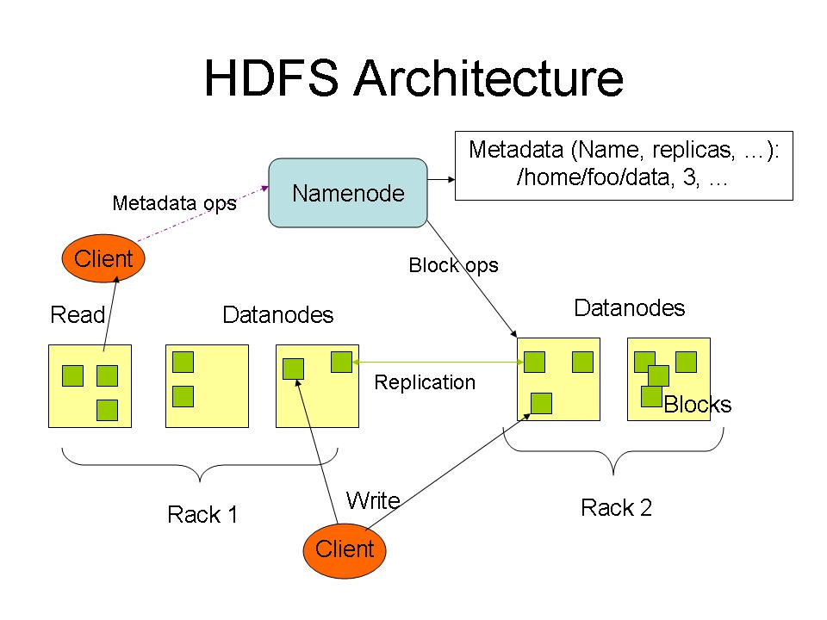

Slide 48
NameNode Metadata
Meta-data in Memory
– The entire metadata is in main memory
– No demand paging of meta-data
Types of Metadata
– List of files
– List of Blocks for each file
– List of DataNodes for each block
– File attributes, e.g creation time, replication factor
A Transaction Log
– Records file creations, file deletions. etc

Slide 49
Namenode Responsibilities
Managing the file system namespace:
Holds file/directory structure, metadata, file-to-block mapping, access permissions, etc.
Coordinating file operations:
Directs clients to datanodes for reads and writes
No data is moved through the namenode
Maintaining overall health:
Periodic communication with the datanodes
Block re-replication and rebalancing
Garbage collection

Slide 50
DataNode
A Block Server
– Stores data in the local file system (e.g. ext3)
– Stores meta-data of a block (e.g. CRC)
– Serves data and meta-data to Clients
Block Report
– Periodically sends a report of all existing blocks to the NameNode
Facilitates Pipelining of Data
– Forwards data to other specified DataNodes

Slide 51
Block Placement
Current Strategy
-- One replica on local node
-- Second replica on a remote rack
-- Third replica on same remote rack
-- Additional replicas are randomly placed
Clients read from nearest replica
Would like to make this policy pluggable

Slide 52
Data Correctness
Use Checksums to validate data
– Use CRC32
File Creation
– Client computes checksum per 512 byte
– DataNode stores the checksum
File access
– Client retrieves the data and checksum from DataNode
– If Validation fails, Client tries other replicas

Slide 53
NameNode Failure
A single point of failure
Transaction Log stored in multiple directories
– A directory on the local file system
– A directory on a remote file system (NFS/CIFS)
Need to develop a real HA solution

Slide 54
Putting everything together…
namenode
job submission node
namenode daemon
jobtracker
tasktracker
tasktracker
tasktracker
datanode daemon
datanode daemon
datanode daemon
Linux file system
Linux file system
Linux file system
…
…
…
slave node
slave node
slave node

Slide 55
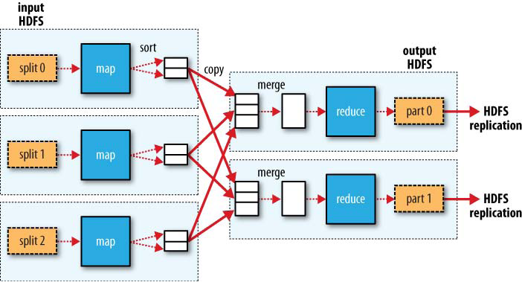
MapReduce Data Flow
Figure is from Hadoop, The Definitive Guide, 2nd Edition, Tom White, O’Reilly

Slide 56
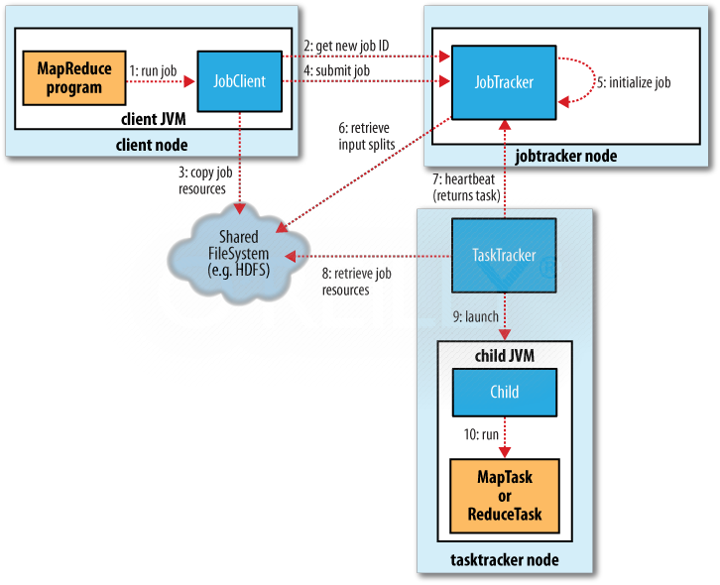
Figure is from Hadoop, The Definitive Guide, 2nd Edition

Slide 57
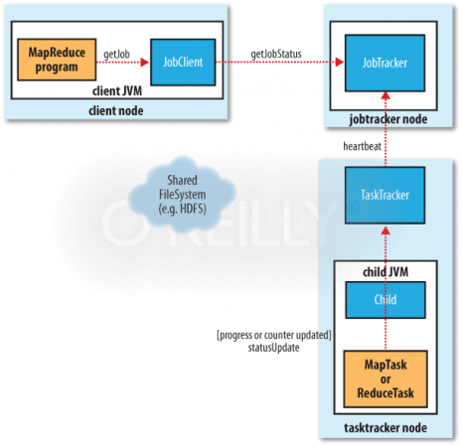
Figure is from Hadoop, The Definitive Guide, 2nd Edition

